Slide 1
Class 13 - Advanced Pandas
[w200] MIDS Python Course

Slide 2
Today’s Agenda
Schedule | Project/Exams
Election Data Discoveries
Analysis Design
Data Vis & Plotting Review (e.g., MatPlotLib)
Project 2 – schedules for presentations, expectations
Final Exam Preparation

Slide 3
1 Schedule | Projects/exams
This week … we review some of our last new material with Panda …
The final exam will be released shortly.
As usual, you have a full week in which to complete the exam. Once starting the exam you have a 24-hour clock.
Please complete the “student evaluation” site when it is convenient for you (before 12/14).
Good luck!
If you need an extension please email your request asap all instructors & TAs!

Slide 4
2 Assignment Review
Discussion: What did you learn from the previous home-works, such as the election data?

Slide 5
3 Pandas | Analysis Design
Think about an analysis as a series of dataset transformations … why?
You might filter out rows based on conditions
You might create new columns
You might aggregate or collapse by groups
You might join two datasets together
The next slide is an example of how our commands can include/exclude data, using SQL and Venn diagrams to demonstrate.

Slide 6
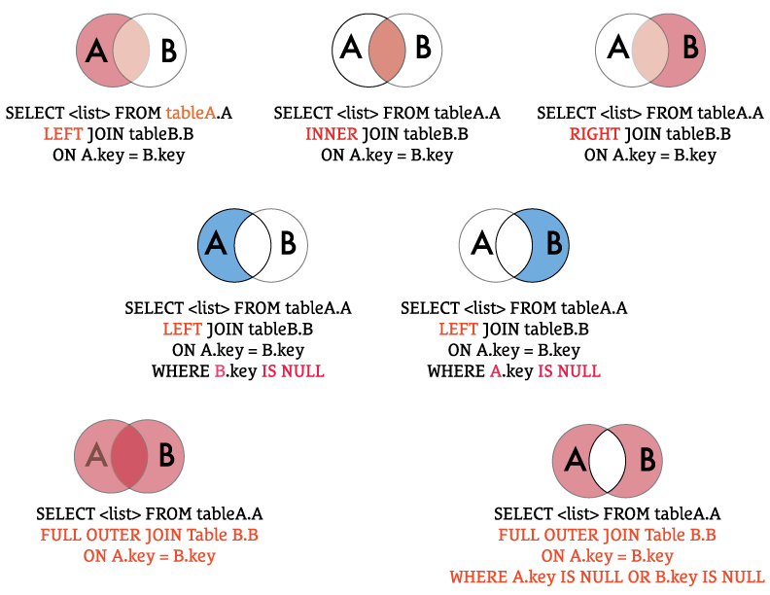
3 Pandas |
Join Types - Discuss

Slide 7
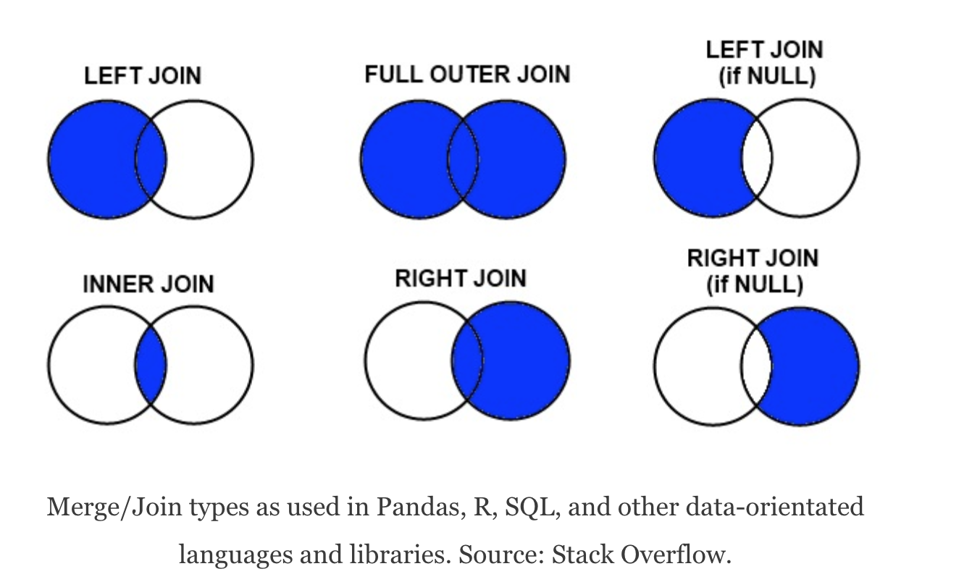
3 Pandas |
Join Types – another diagram
https://www.shanelynn.ie/merge-join-dataframes-python-pandas-index-1/

Slide 8
3 Pandas | Some Functions
groupby()
cut()
agg()
apply()
reset_index()
pivot()
There’s an example of “groupby” on the next slide to suggest how we create the data, group those data, and then start to review/analyze them.

Slide 9
import pandas as pd
raw_data = {‘Group’: [‘Cats’,’Cats’,’Cats’,’Dogs’,’Dogs’,’Dogs’],
‘company’: [‘1st’,’1st’,’2nd’,’1st’,’2nd’,’2nd’,’1st’],
‘name’: [‘Tom’, ‘Jane’, ‘Abdul’, ‘Ming’, ‘Jeff’, ‘Toby’],
‘preTestScore’: [5, 5, 4, 3, 4, 5],
‘postTestScore’: [6, 6, 7, 7, 6, 6]}
df = pd.DataFrame(raw_data, columns=‘Group’,’company’,’name’,’preTestScore’, ’postTestScore’])
Create some data and a frame …
groupby_group = df[‘preTestScore’].groupby(df[‘group’])
# use list to see ‘em…
list(df[‘preTestScore’].groupby(df[‘Group’]))
# descriptive stats by group
df[‘preTestScore’].groupby(df[‘Group’]).describe()
Group and
list these
data to examine.
Why not some desc stats, too?
for name, group in df.groupby(‘Group’):
#print group name
print(name)
# print the data of that Group
print(group)
Let’s view and
perhaps share
these results.

Slide 10

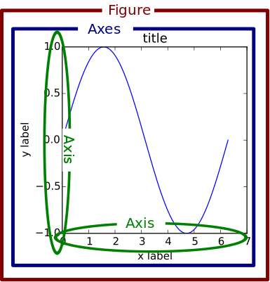
4 Data Vis & Plotting (Overview)
fig = plt.figure() #empty figure with no axes fig, ax = plt.subplot() # a figure and axes
Recall: We need a “container” to hold the drawing area.
In matplotlib we might use a “figure” object; in HTML5 there’s the “Container” object; in Java we have JFrame; in Adobe Illustrator you’ll encounter the “bounding box.” They’re all functionally the same - they designate a Graphic drawing area for “painting” your data.
Note, btw, that most of the drawing area commands may have a built-in “erase - then paint” command. Just FYI.

Slide 11
4 Pulling it All Together | Demo
We’ve seen how matplotlib + seaborn are popular and with practice become useful tools in your DataSci arsenal. In practice people often combine Stata, R, NumPy, Pandas and other tools for data cleaning, analysis, statistical work, and presentation of data.

Slide 12
5 Project 2 | Preliminary presentation
This will be mostly a “working session” for project teams. We will balance time between your project group and breakouts where you can discuss challenges with others.
Let’s work up to a 2-minute “elevator pitch” on their project to the full room, followed by 2-minutes of Q&A. Please pick whom you would like to present.

Slide 13
5 Grading | Reminder of Breakdown
Homework (30%)
Midterm (10%)
Project 1 (20%)
Final (10%)
Project 2 (20%)
Participation (10%)

Slide 14
5 Project 2 | Grading
Proposal (10%)
10-15 Minute Final Class Presentation (20%)
Report (70% as follows)
Lay out the question and describe the data set clearly. That includes defining columns and the source of the data (10 pts)
Check the data for internal inconsistencies and convince us that you know your dataset (20 pts)
Tell a story that shows significant exploration of the data set in text and appropriately figures (40 pts)
Roughly 20 pts will relate to your text, and 20 pts to your figure -- but we may be flexible on this if you have particularly compelling stories or figures

Slide 15
Project 2 |The Team Review
Contributions in the paper (e.g Jim Bond: data cleaning -70%, writing 10%)
You may also be asked to answer a quick survey about your team to ensure everyone has contributed.

Slide 16
5 Project 2 | Team Feedback
We’ll take 30 minutes now to let you work as a group.
For the first + 10 minutes, you will be with your group to plan and discuss your project.
For the second + 15 minutes, I will combine groups together. Discuss your projects, and give each other feedback.
For the last + 5 minutes, you will be back with your own team to recap and close out.

Slide 17
6 Final Exam | Logistics
Final Exam (10%) - Due by Class 14.
You will have 24 hours to complete the exam. It will cover:
Object Oriented Programming (briefly)
Data Analysis
Much of the exam will be short answer or discussion format
There will be some short problems that require you to code.

Slide 18
6 Final Exam | Review
We know and you know you can program in Python!
Let’s give you a chance to write about your knowledge, too.
What is inheritance?
What is polymorphism?
Why might you use either?
What are the products in the PyData Ecosystem?
When should you use NumPy? What about Pandas?
Let’s talk about how to explore a dataset… what do you do?
Why is data exploration important? Make up a horror story.
What is a good process for designing an analysis?
What are two methods of accessing variables in a dataset?
What is the difference between “groupby” and “agg”?

Slide 19
Thanks!
Before we progress to your presentations, we are all glad to have had each of you in our classes and the DataScience program.
Thanks for all your hard work and persistence. Best wishes for great success in the exam and your presentations and, of course, in all your MIDS courses.

